Slide 1
The need for interest rate normalisation given the changing global setting
Monetary Policy Committee
Mr. Dooneshsingh Audit, Chief Policy Unit & Mr. Fadil Dookhy, Chief Reserve Management Unit
14 July 2014

Slide 2
Turnaround in monetary policy globally has already started

Slide 3
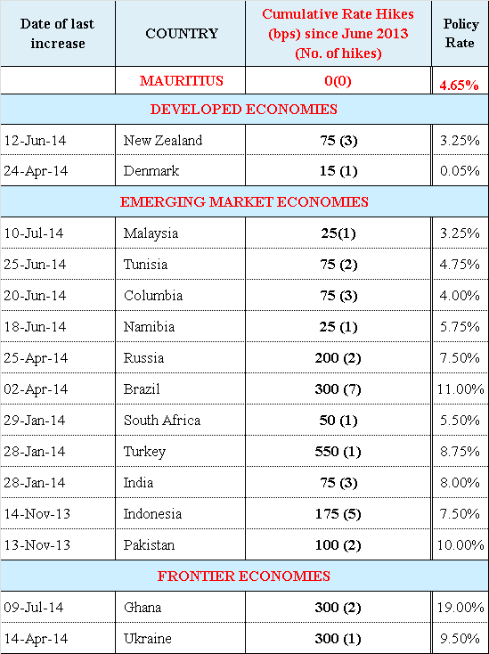
Turnaround in Monetary Policy
Several countries have already provided the tightening direction.
Many countries are concerned about the impact of persistent low interest rate on asset prices.
Emerging countries are adapting to the turnaround in monetary policy and preparing their exit and restoring currency stability.
Source: www.tradingeconomics.com, www.cbrates.com

Slide 4
… in US and UK…
US Fed has been proceeding with its QE tapering at the pace decided at the December 2013 FOMC meeting.
The US has the advantage of its currency and a continuum of innovations (shale gas innovation in US has helped the US cut current account deficit by 50%) to continue with low interest rate, but not all countries can have this luxury.
In the UK, market has been pricing a hike in interest rate sooner than expected – but Governor Carney is deferring the hike as much as possible.
But, housing prices have been a concern, the QE was modified to reach out SMEs, Macroprudential measures have been introduced and UK Chancellor’s recent budget focus on incentivising SAVERS.

Slide 5
Normalising economic activity worldwide and rising risk appetite

Slide 6
Global Economy
Globally, risk appetite is growing as a number of uncertainties have either been resolved or are being tackled by a relatively swifter policy response.
Advanced economies improvements are better sustained.
The US and UK economy have already made good progress, in particular with respect to the labour market and asset prices.
In the euro area, while growth has improved, entrenched deflationary conditions are new concerns. But, they are specific to the euro area. Several risk factors in the euro area have been eliminated.
Although Emerging economies have moderated, the pick-up in capital flows and return to exchange rate stability suggest emerging countries’ growth could be firmer ahead.
Improvement in Advance economies can also be expected to have positive spillover effects on emerging economies
In China, development of domestic market can be expected to stabilise the moderating growth.
Positive outlook on India, benefiting from stabilized exchange rate and improved business sentiment with the new leadership in place.

Slide 7
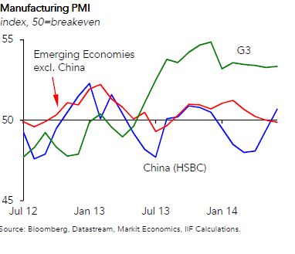
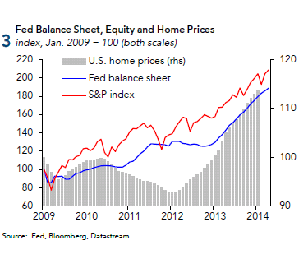
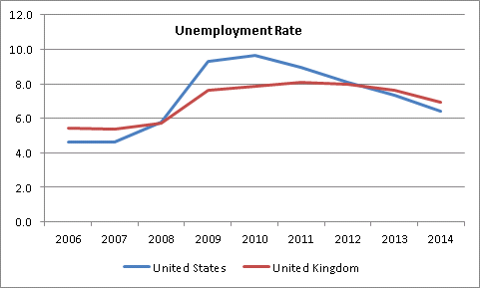
Global Economy – a few highlights …
Source: Institute of International Finance

Slide 8
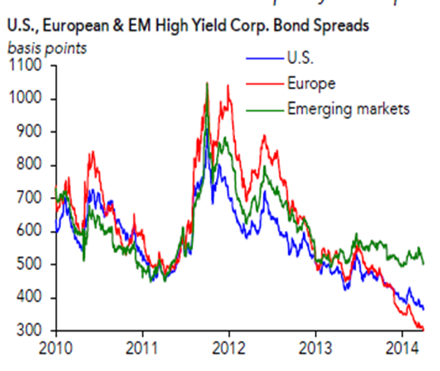
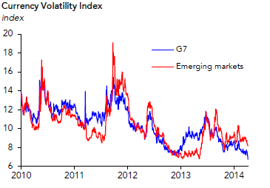
Normalising risk appetite globally as a result of reduction in uncertainties…
Significant reduction in bond spreads observed.
Currency volatility has also come down.
Risk premium is on a downward trend as a result of less uncertainties while risk appetite is growing.
Asset prices need to be better monitored and considered in the decision-making process.
Source: Institute of International Finance

Slide 9
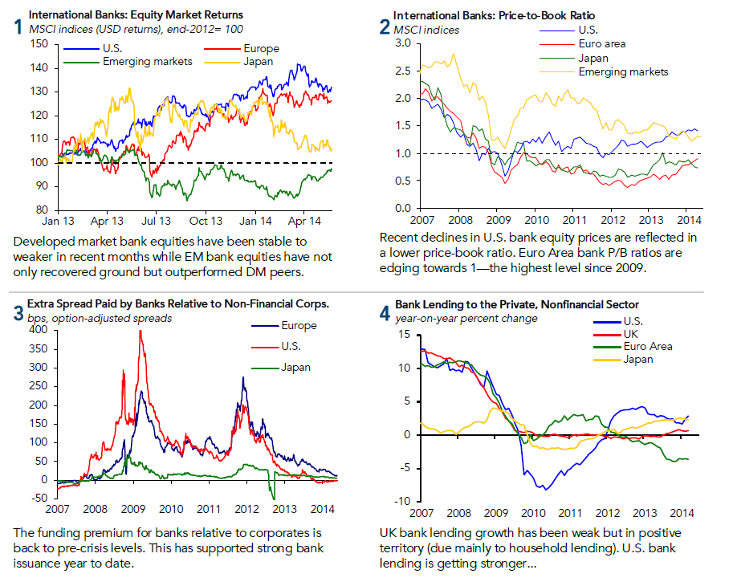
Banks at the core of economic activities have improved substantially …
Source: Institute of International Finance

Slide 10
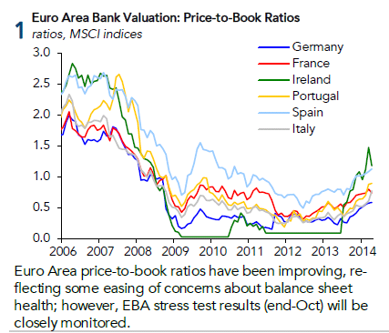
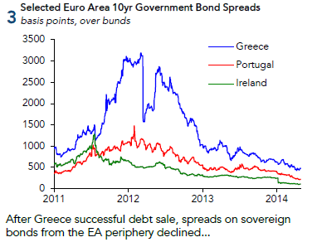
Lower risks factors in the Euro Area …
Several Credit Rating upgrades (Portugal, Spain and Greece)
The era of constant downgrades is being replaced with more news on upgrades.
Greece, which a year ago was seen to not be able to recover soon, has been showing increasingly good results.
Although growth is weak, the progress is visible and more importantly sustained.
The deflationary concerns are linked to low wage growth, negative bank credit growth and value of the euro.
Source: Institute of International Finance

Slide 11
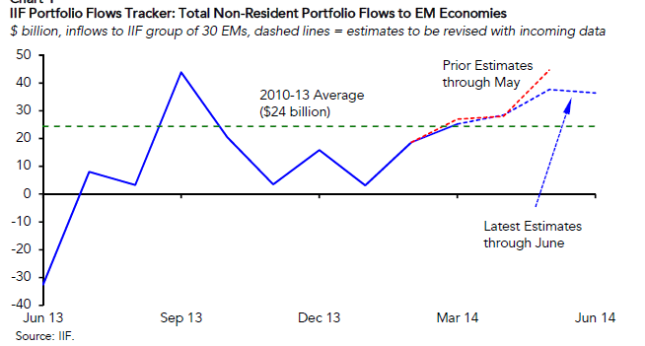
Capital flows to Emerging Economies – No more under pressure
Estimates by Institute of International finance (IIF) indicate capital flows in Emerging economies to have stabilized – US$36 billion in June and US$38 billion in May 2014.
Emerging Economies have demonstrated much resilience to FED QE tapering .
Emerging markets have in recent years also been expanding their domestic markets.
Source: Institute of International Finance

Slide 12
What the experts are cautioning us of?
Avoid repeating the mistakes that led us to the global financial crisis …

Slide 13
Some experts: “…normalise before it is too late…”
“…Sustained periods of Negative Real Interest Rates can lead to dangerous risk-taking…”(IMF April 2014)
BIS general manager Jaime Caruana, chief economist Claudio Borio, and newly installed head of research Hyun Song Shin, cautioned that monetary policy has been "overburdened for too long", arguing central banks should urgently turn their focus to "the risk of normalising too slowly and too late". (BIS June 2014)
New York Fed President Dudley and BoE Governor Carney have indicated their preference to start raising interest rate before ending Quantitative Easing.
This means that interest rate cannot be viewed in the narrow microeconomic sense of equilibrium price between demand and supply for loanable funds.

Slide 14
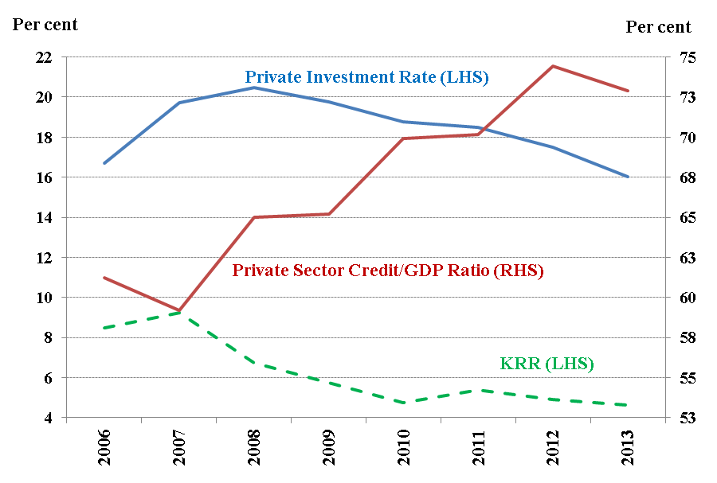
Investment and Credit Allocation…
Low interest rate has not boosted investment
But, credit to private sector has been growing.
Credit flowing into real estate and construction sectors – not in sectors that will generate growing flow of other economic activities.
The Bank introduced Macroprudential measures to reduce vulnerabilities associated with credit risk concentration.
Persistence of cheap credit may cause more harm in the long-run.

Slide 15
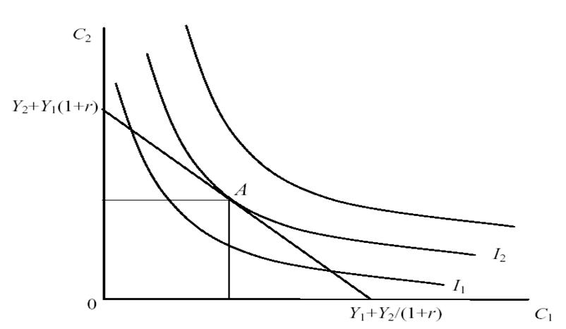
Excess liquidity and Interest Rate
Interest Rate is the economic variable equilibrating the choice between present and future outcomes.
The problem of excess liquidity to some extent could be due to a bias in favour of current outcomes in the past against future outcomes, which is now.
The view to look for a more “normal” interest rate could lead us to more optimal macroeconomic and intergenerational outcomes.
Further the problem of excess liquidity also needs to be viewed in terms of the current market structure – 3 banks hold more than 65% of the excess liquidity. – Could it also be a market structure problem ?
The policy response then cannot be symmetric –market imperfection has to be corrected or its impact mitigated.

Slide 16
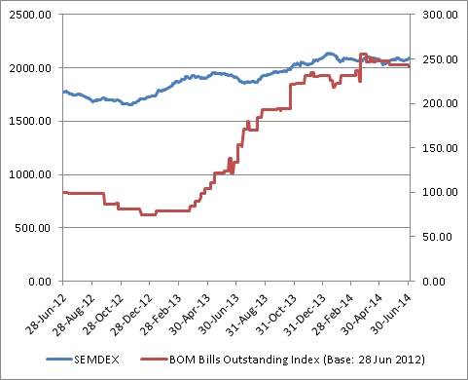
SEMDEX and Liquidity Management..

Slide 17
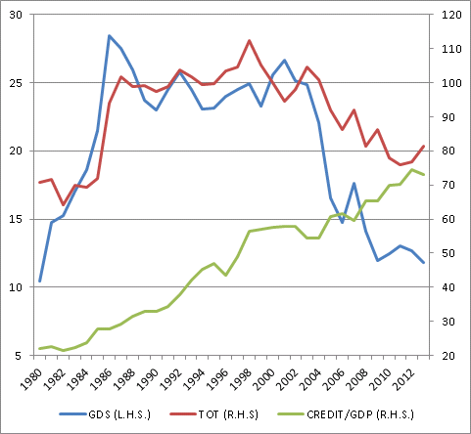
Terms of trade, Credit/GDP and Savings

Slide 18
Persistent divergence within the MPC … inappropriate signal to the market.
Divergence within the MPC, in particular, when raising interest rate was warranted, has led some commercial banks to decide on interest rate on their own – breaking down the monetary policy framework.
The Monetary Authority needs to be better supported within the MPC to have its mandated influence on the banking sector.
To restore the mandated influence of the Monetary Authority, the MPC work needs to have a more collegial approach.

Slide 19
Summary of findings on Taylor Rule application presented at last MPC
Scenarios |  |  | Does the neutral rate exceed the KRR? | When does the neutral rate exceed the KRR? | By how much does the neutral rate exceed the KRR?
Backward Looking Taylor Rule |  | Inflation target - 3% | Yes | 2014Q1 | 270 bps
 |  | Inflation target - 4% | Yes | 2014Q1 | 220 bps
 |  | Inflation target - 5% | Yes | 2014Q1 | 170 bps
 |  | Historical Inflation Average | Yes | 2014Q1 | 150 bps
Modified Taylor Rule |  |  | Yes | 2013Q4 - 2014Q1 | 110bps : 120bps
Taylor Rule adjusted for imperfect control over the domestic money market | W_{Inflation}= 1.5 W_{GDP} = 0.3 |  | Yes | 2013Q4 - 2014Q1 | 21bps : 56 bps
 | W_{Inflation}= 0.5 W_{GDP} = 0.5 |  | Yes | 2013Q4 - 2014Q1 | 18 bps : 60 bps

Slide 20
Where could the “normal” interest rate be?
Taylor Rule provides an estimate of how the policy rate must adjust to growth and inflation outcomes but does not provide a view of where the Long-run “normal” rate could be.
There is an emerging view that the long-run “normal” rate could be around the Long-run average growth rate of Nominal GDP.
Mauritius’ Average Nominal GDP growth has been as follows:
Period 2000-2005: 9.8%
Period 2006-2010: 9.4%
Period 2011-2014e: 6.7%
We need not target the 6.7% since it is a long-run estimate, but we have a sense of where we need to bring the interest rate.
The “normal” interest rate may be in the range of 4.65% and 6.7%.

Slide 21
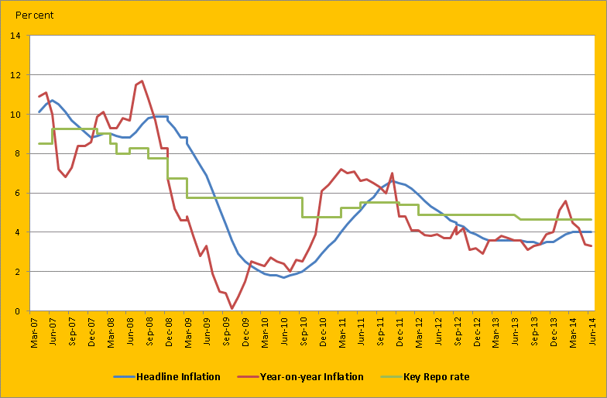
The Key Repo Rate currently at its lowest …
We need a smooth exit strategy to avoid policy surprises…
Better choose the exit at our pace than being forced on a path…

Slide 22
Why normalise Interest rate?
Turnaround in monetary policy has already started globally
Smooth exit strategy from the current accommodative monetary policy
Normalising economic activity and risk appetite worldwide
To avoid repeating the mistakes that led us to the global financial crisis
Better balance the trade-off between current and future outcomes
Excess liquidity could to some extent be the repercussions of excessive cheap credit flowing into non-productive sectors
Need to correct for emerging macroeconomic imbalance
Incentivise Savings to redress consumption pattern

Slide 23
Why normalise Interest rate?
Restore the mandated influence of the Monetary Authority on the banking sector.
Management of expectations and financial stability are increasingly important for long-run price stability
The policy direction has considerable impact on expectations and concurrently on economic behaviour and hence macroeconomic outcomes
We need to give economic agents a direction of where future interest rate would most likely be to void out potential macroeconomic imbalance.

Slide 24
Thank you

