Slide 1
Monetary Policy Committee
GDP growth and Inflation Outlook
Dr A. Aubeeluck (Head - Economic Research Division)
and
Dr A. Madhou (Chief - Economic Research Division)
14 July 2014

Slide 2
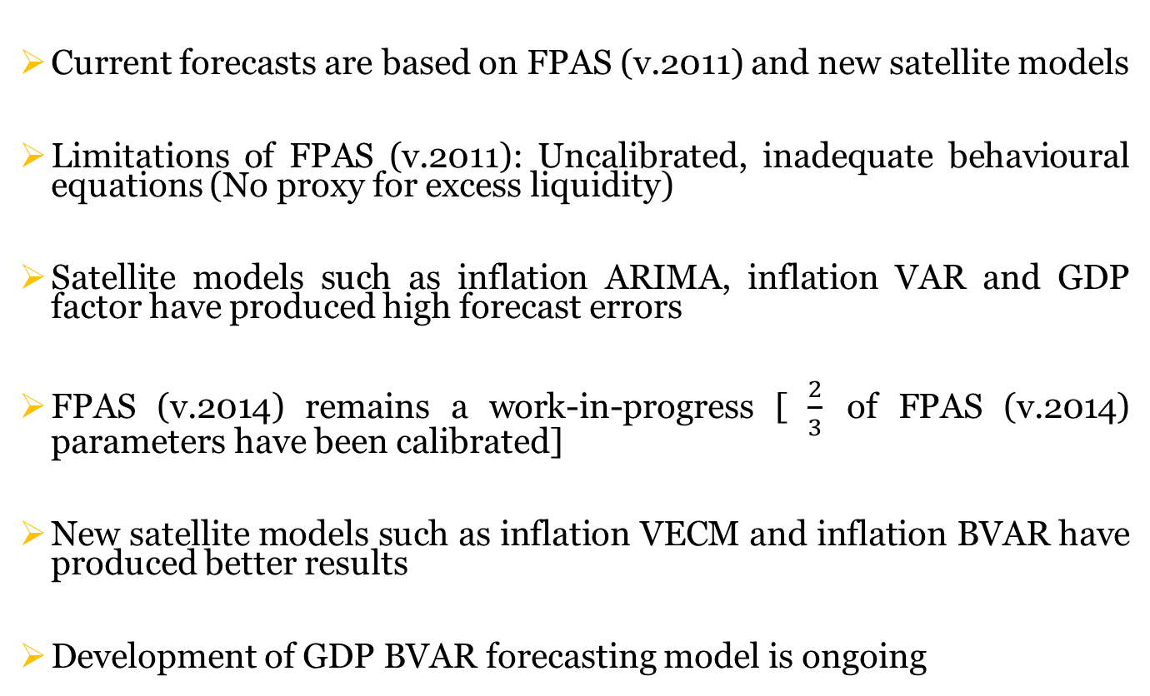
Technical Specifications
Current forecasts are based on FPAS (v.2011) and new satellite models
Limitations of FPAS (v.2011): Uncalibrated, inadequate behavioural equations (No proxy for excess liquidity)
Satellite models such as inflation ARIMA, inflation VAR and GDP factor have produced high forecast errors
FPAS (v.2014) remains a work-in-progress [ $\frac{2}{3}$ of FPAS (v.2014) parameters have been calibrated]
New satellite models such as inflation VECM and inflation BVAR have produced better results
Development of GDP BVAR forecasting model is ongoing
2

Slide 3
Global Output Growth
 | 2013 | 2014E |  |  | 2015E |  |  | 2016-2018E
 |  | Bear | Base | Bull | Bear | Base | Bull
Global | 3.0 | 2.5 | 3.2 | 3.7 | 2.8 | 3.7 | 4.6 | 3.7
G10 | 1.2 | 1.3 | 1.8 | 2.2 | 1.4 | 2.2 | 3.0 | 1.8
Emerging Markets | 4.8 | 3.7 | 4.6 | 6.1 | 4.2 | 5.2 | 5.8 | 5.3
Source: Morgan Stanley Research (June 2014)
World Bank global growth projections have been marked down from 3.2 percent in
January 2014 to 2.8 percent
Notwithstanding the early weaknesses, global growth is expected to pick up as the year progresses.

Slide 4
Assumptions for FPAS
Implicit inflation target is assumed to be 4%
Potential output growth is assumed to be 4.5%
Trend level of domestic real interest rate is 1%
Trend change in the real exchange rate is -4%
Trend level of foreign real interest rate is 1%
Foreign inflation target is assumed to be 2%

Slide 5
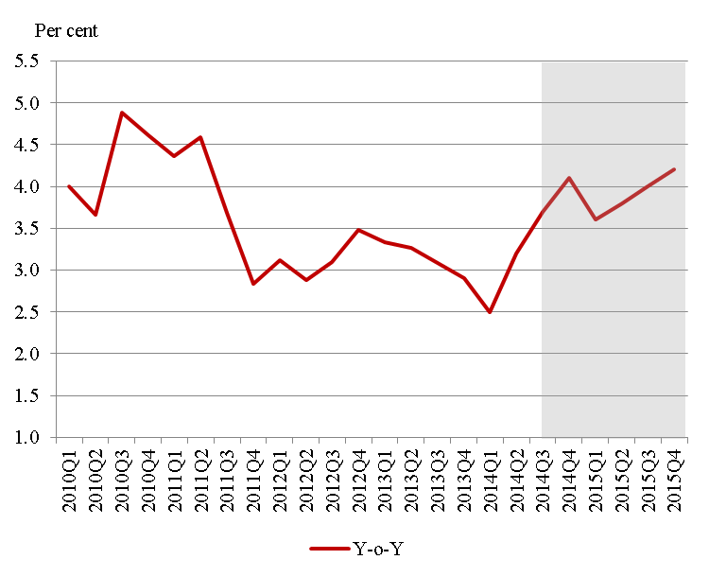
GDP Growth Forecast
GDP growth is projected to reach 3.7 percent in 2014Q3 and 4.1 percent in 2014Q4
Growth outlook for the year 2014: 3.4 – 3.6 percent
However, over the previous quarters, the forecast error of the core model has not been within tolerable margins. The core model is presently being upgraded and remains a work –in-progress.

Slide 6
Medium-Term Forecasts
Variable | Frequency | 2014Q3 | 2014Q4 | 2015Q1 | 2015Q2 | 2015Q3 | 2015Q4
CPI | % (Y-o-y) | 4.1 | 4.1 | 3.4 | 4.8 | 4.7 | 4.5
CPI | % (Q-o-q) | 5.0 | 5.0 | 4.5 | 4.6 | 4.5 | 4.4
The core model forecasts inflation to fluctuate within the 4-5 percent band throughout the projected period.
However, over the previous quarters, the forecast error of the core model has not been within tolerable margins. The core model is presently being upgraded and remains a work-in-progress.

Slide 7
Baseline Assumptions for VECM & BVAR
Key Repo rate is assumed to remain unchanged as at end of June 2014.
Three-month Treasury-bill is assumed to remain unchanged for the months April to June.
CPI Europe is expected to grow at the rate of 0.7% as at 2014Q2 to 1.3% as at 2015Q3 (Reuters Poll).
Private sector credit is assumed to grow at 2 percent monthly.
GDP Europe is projected to rise from 0.2% as at 2014Q2 to 0.4% by 2015Q3 (Reuters Poll).

Slide 8
Near-Term Forecasts
Model | 2014Q3 | 2014Q4
VECM | 3.6 | 3.7
BVAR | 3.5 | 3.3
The forecast results of the VECM and BVAR are robust for the 1st and 2nd quarters only.
In-sample forecast errors (RMSE) of VECM and BVAR have been relatively low.

Slide 9
Comparison of Forecasts
 | Growth Forecast | Inflation Forecast
Domestic Agency
Bank of Mauritius | 3.4 – 3.6 | 3.7 – 4.2
Statistics Mauritius | 3.5 | n.a
International Agencies
IMF | 3.7 | 4.5
World Bank | 4.1 | n.a
Economist Intelligence Unit | 3.7 | 3.8
African Economic Outlook (AFDB, OECD & UNDP) | 3.5 | 3.6
Private Sector (domestic)
Pluriconseil | 3.3 - 3.6 | 4.0 - 4.4
KPMG (Mauritius) | 3.8 - 4.0 | n.a
Mauritius Commercial Bank | 3.3 | 3.9
BDO Mauritius | 3.8 | 4.5
MCCI | 3.4 | 4
Private Sector (foreign)
Capital Economics | 4.0 | 4.0
Range | 3.3 - 4.1 | 3.3 - 4.5

Slide 10
Thank you

