Slide 1
Monetary Policy Committee
Recent Economic Developments
M. Heerah-Pampusa
Head - Economic Analysis Division
14 July 2014

Slide 2
Main Points
Confirmation of stronger global growth in 2014
  Decoupling among advanced economies
  Slow pace of growth in emerging markets possibly bottoming out
  Global inflation picture benign – recent increase in oil prices could be a risk
Domestic output to benefit from international developments
Some downside risks
  External demand
  Domestic demand

Slide 3
External Environment
3

Slide 4
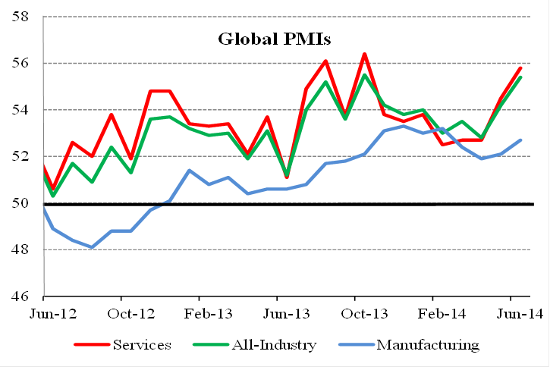
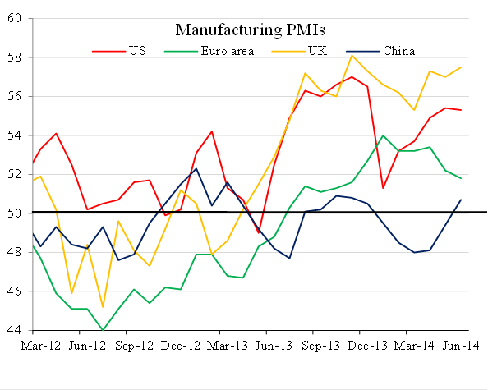
Expansionary near-term outlook
Source: JP Morgan.

Slide 5
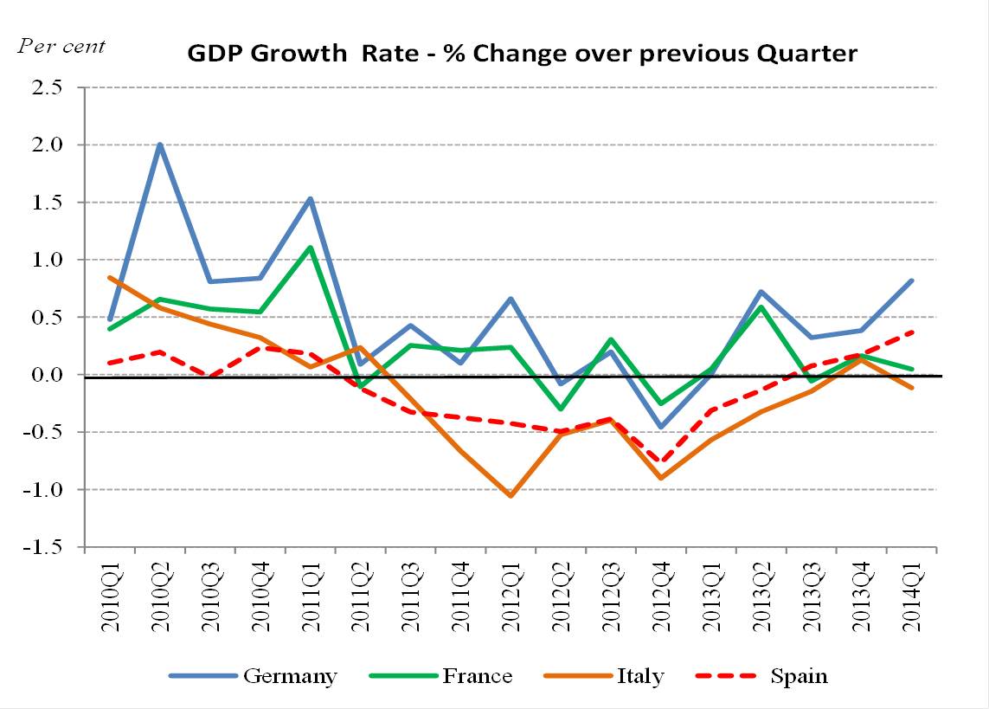
Mixed Performance in Eurozone
Source: OECD.

Slide 6
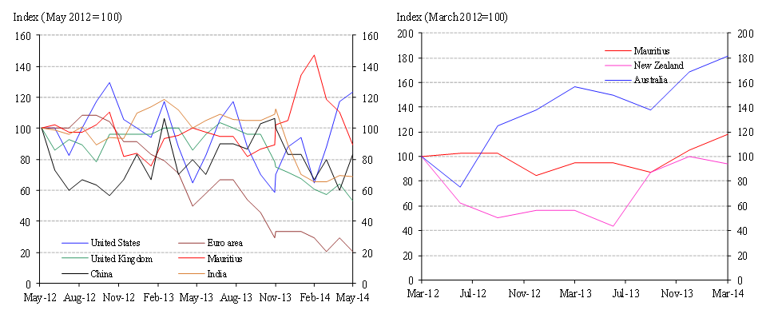
Moderate global inflation …..
June 2014 Reuters poll: mean inflation rates in the US, UK and euro area are expected to be around 2.1 per cent, 1.9 per cent and 0.9 per cent, respectively, by end-2014.

Slide 7
…… but some upside risks from higher oil Prices
FAO Food Price Index
Oil Prices
EIA Forecast for Brent crude oil prices: $108 a barrel in 2014.
Sources: FAO and Reuters.

Slide 8
Developments in the domestic economy since the last
MPC meeting

Slide 9
Slower growth in 2014Q1

Slide 10
Output gap assessed to be negative …

Slide 11
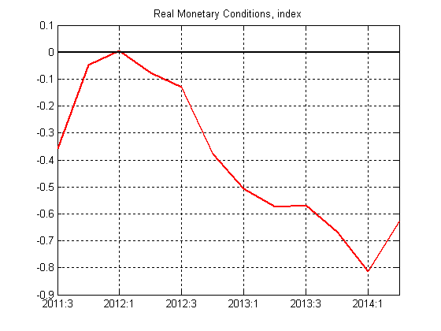
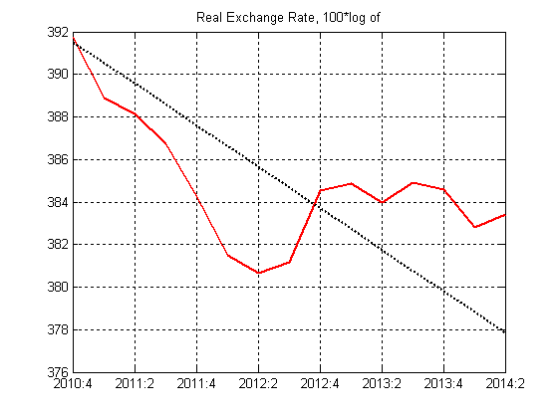
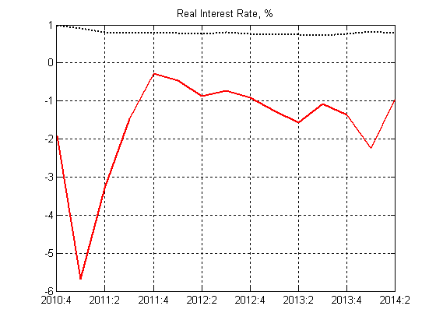
… while monetary conditions continue to be accommodative

Slide 12
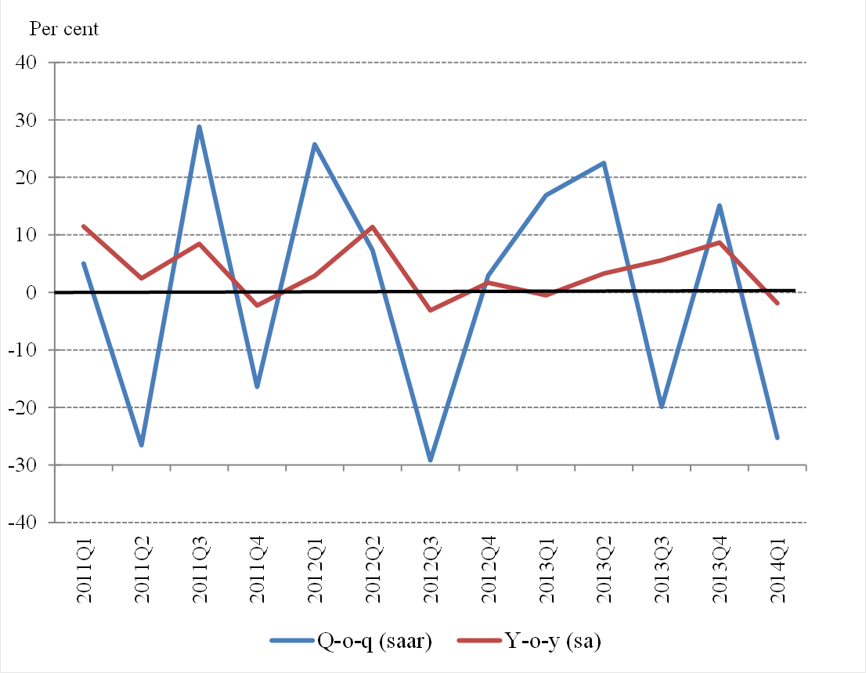
Exports: moderate growth

Slide 13
External Trade
Exports
Per cent
Imports
Per cent

Slide 14
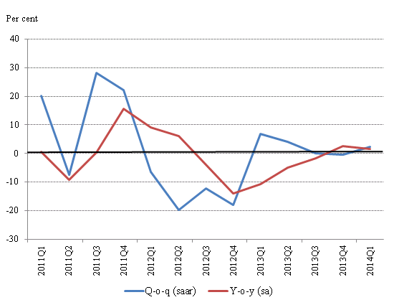
Investment: slow recovery from 2012/2013 lows
Continued contraction in Building and Construction work in 2014Q1 (-3.2%), but machinery & equipment up by 11%.
GDFCF to grow by 0.4% in 2014 , but to contract by 0.8% excluding aircraft and marine vessel. This is compared to contraction of 3.3% [6.7% excl. aircraft & marine vessel] in 2013.

Slide 15
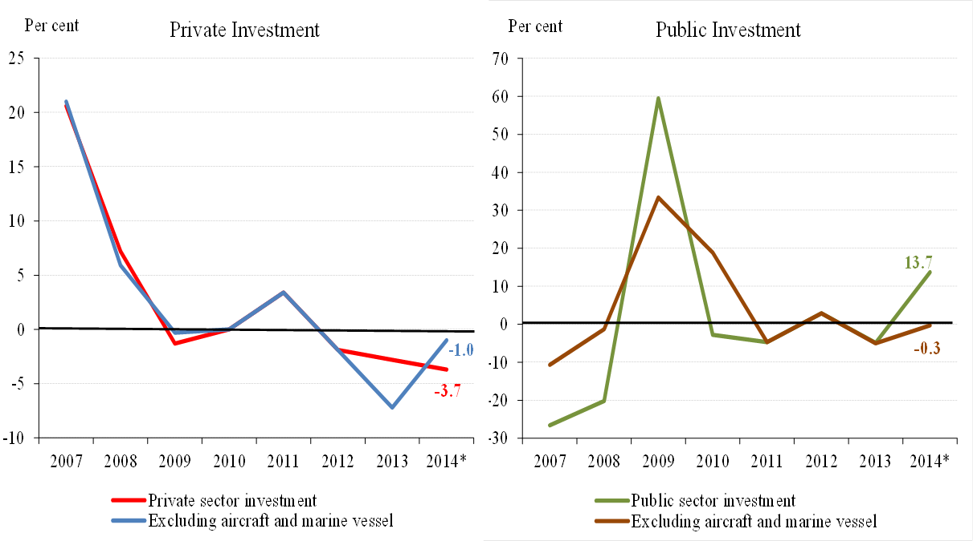
Growth in GDFCF driven by jump in public investment
2014* - Forecast.

Slide 16
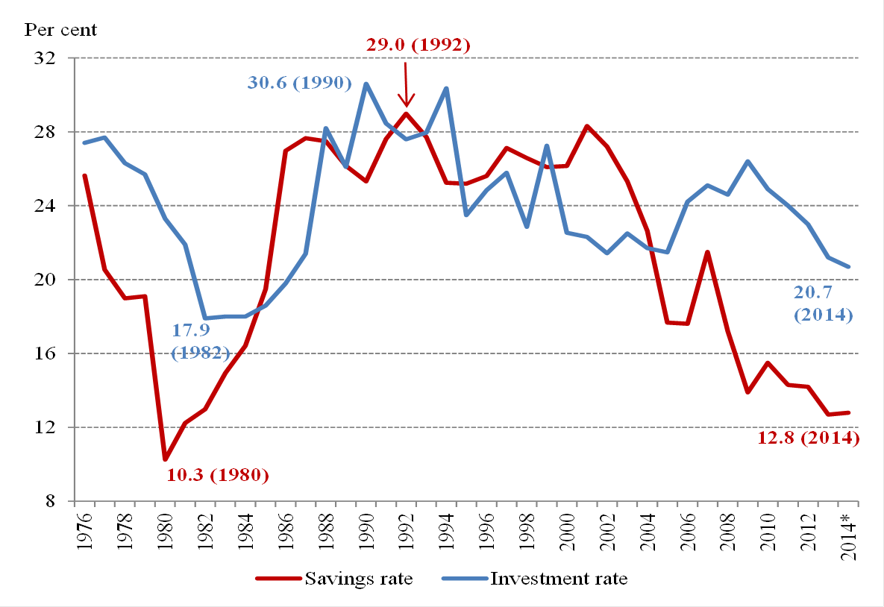
Declining savings and investment rates
2014* - Forecast.

Slide 17
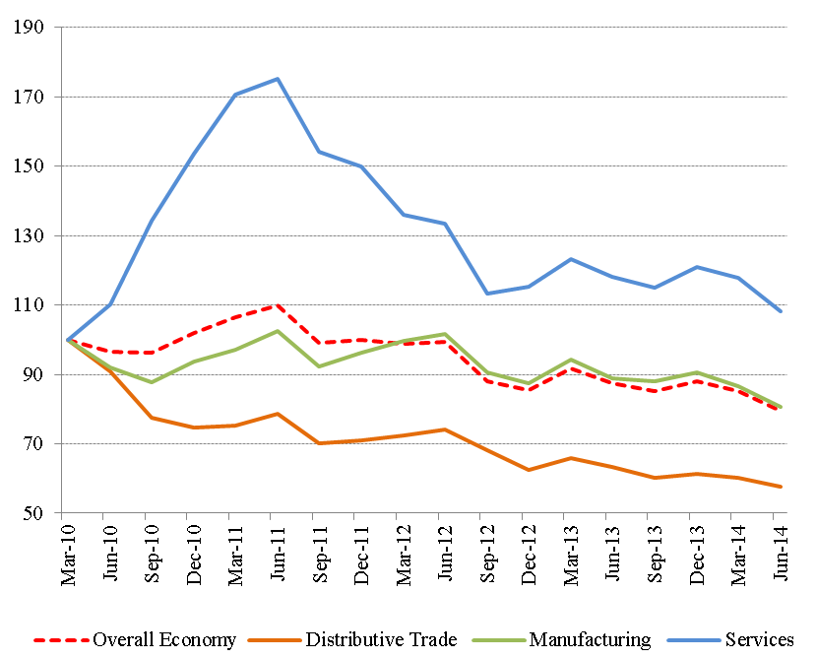
MCCI Business Confidence Index (June 2014)
Indicator fell to 79.6 points in 2014Q2.
Underlying factors:
subdued domestic demand, fierce competition in the local market, cost of capital, lack of skilled labour, unfavourable exchange rate.

Slide 18
Pluriconseil Barometer

Slide 19
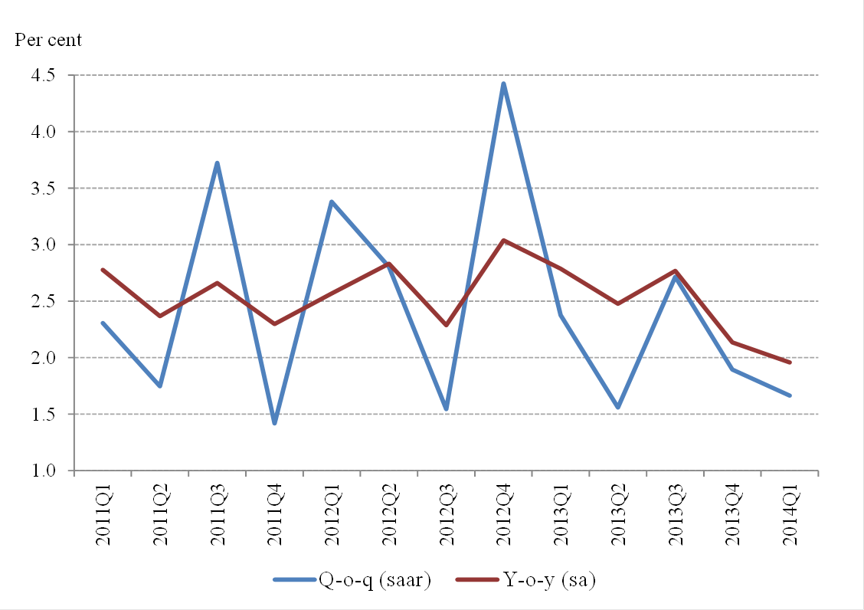
Consumption: slight pick-up expected in 2014
Final consumption growth of 2.6% in 2014 compared to 2.3% in 2013
Private consumption growth projected at 2.8% in 2014, from 2.6% in 2013
Govt consumption growth to increase to 2.0%, from 0.7%

Slide 20
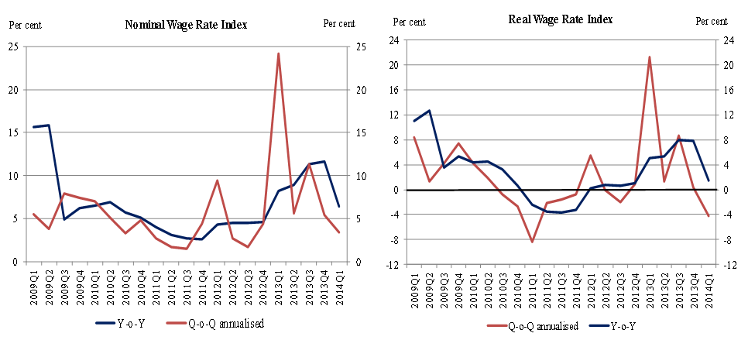
Labour market

Slide 21
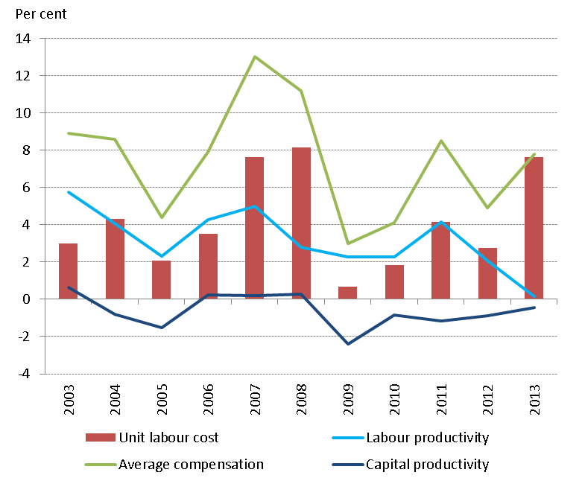
Decline in productivity

Slide 22
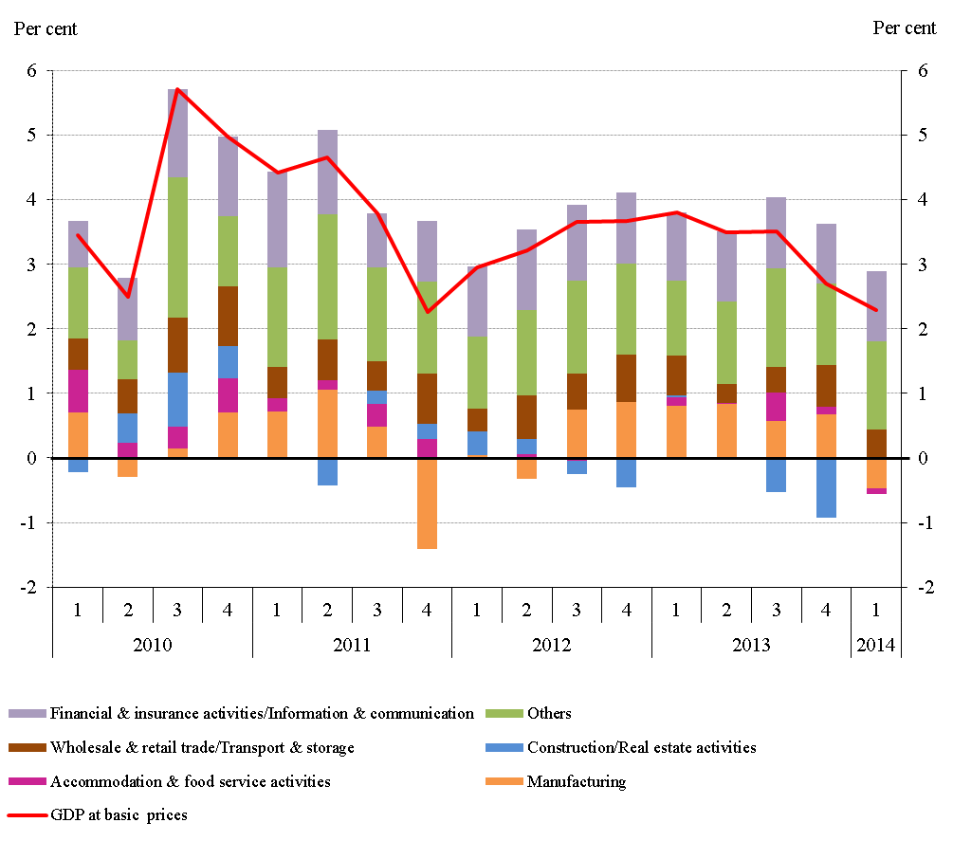
Sectoral Contribution to Growth

Slide 23
Y-o-y growth rates in some key sectors
For 2014, SM expects growth of 5.3% in ‘financial and insurance activities; 3.5% in ‘accommodation and food service activities’; and 1.7% in manufacturing;
Construction may contract by 4.8%

Slide 24
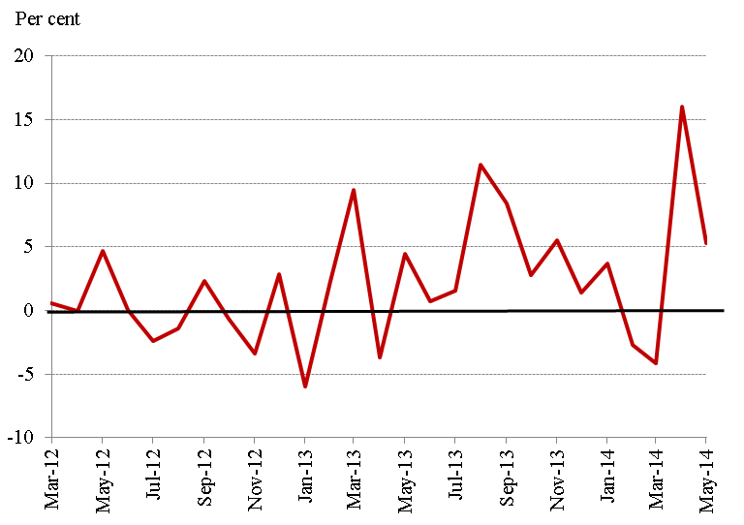
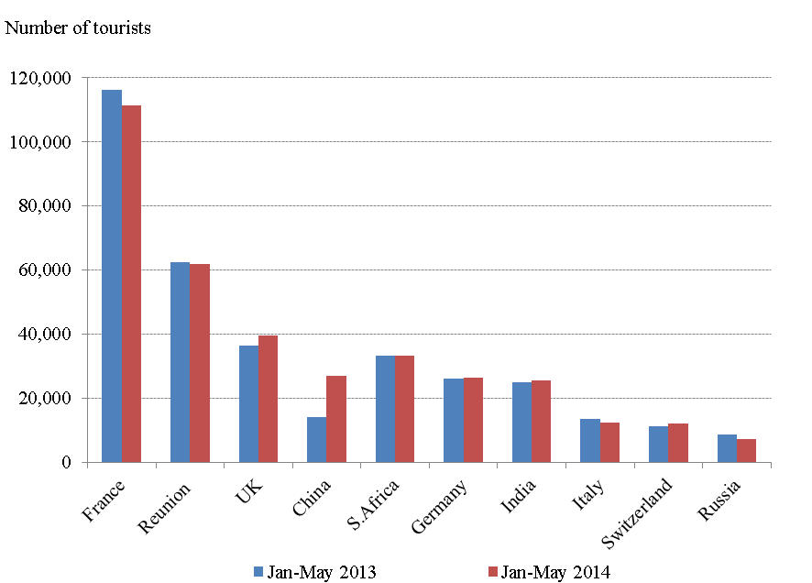
Improvement in tourist arrivals
Tourist arrivals increased by 5.3% y-o-y in May 2014.
Y-o-y growth of 3.3% during period Jan-May 2014
Forecast of 1,030,000 arrivals in 2014.

Slide 25
Fall in tourist earnings expected to be reversed
Fall of 2.1 per cent y-o-y for the first five months of 2014 to Rs19.2 bn
Projected increase of 9.7% to Rs44.5 bn for 2014

Slide 26
Recap
  Slower growth in 2014Q1
  But, improving international environment should have positive impact on external demand going into 2014H2
This should translate in a gradual improvement in domestic demand

Slide 27
Thank you

